Slide 1

SWS3009
Lecture 2
Generative Networks
colintan@nus.edu.sg

Slide 2
Generative Networks
In yesterday’s lecture we looked at deep learning networks that could be used for detecting and recognizing objects, and to do time-series analyses:
Long-short term memory networks and Transformers
Convolutional Neural Networks
Object Detection Networks
Today we continue with Generative Networks.
These are networks that can produce new “fake” data from existing data.
Great for generating extra training data, and for robots learning to operate in imaginary environments.
Architectures we will look at today:
Autoencoders
Generative-Adversarial Networks
Diffusion Networks
Note that LSTMs and Transformers are also technically generative networks.

Slide 3
autoencoders
SWS3009 Embedded Systems and Deep Learning.

Slide 4
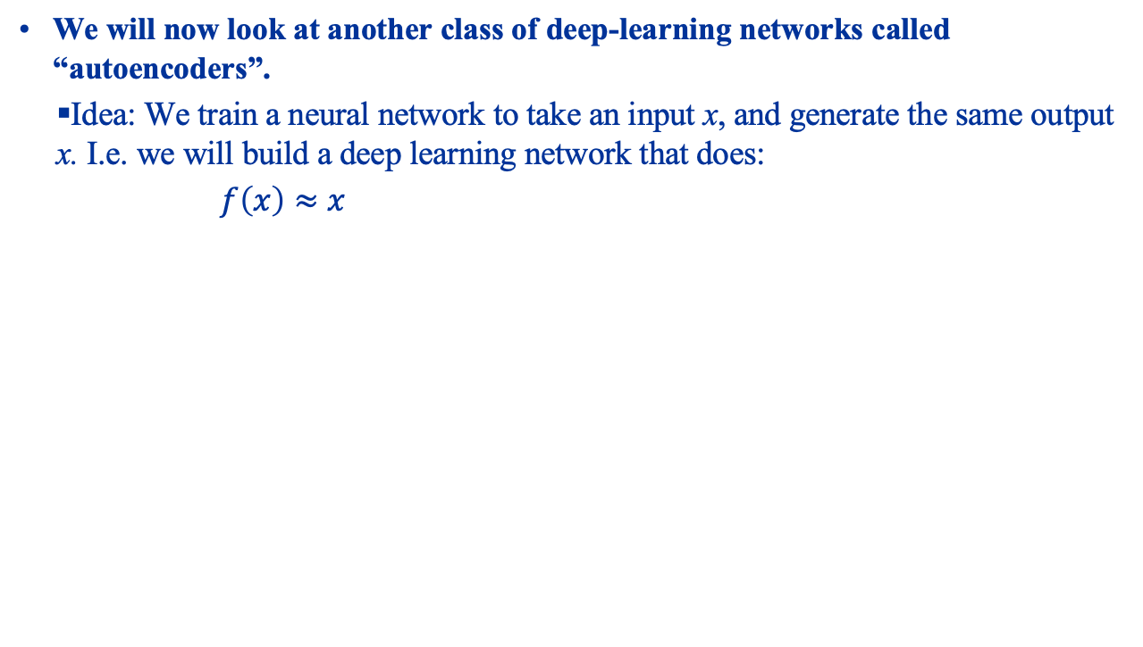
Autoencoders What Are They?
We will now look at another class of deep-learning networks called “autoencoders”.
Idea: We train a neural network to take an input x, and generate the same output x. I.e. we will build a deep learning network that does:
$f\left(x\right)≈x$
Latent Vector

Slide 5
Autoencoders Motivation
Why would we do this? Two reasons:
We can achieve “compression”:
If the “code layer” is substantially smaller than the input, we can feed in the input and use the resultant “code” as a compressed version of the input.
We can feed this code into the decoder network to recover the original.
However AEs are very bad at this: the recovered data will be highly “lossy”, and the AE can only reconstruct data of the type it was trained on.
We can detect anomalies:
When the AE sees “typical” data it was trained on, it can reconstruct the input with minimal error.
When the data becomes atypical, reconstruction error rises. We can flag anomalies when this error exceeds a threshold.
We can generate new data:
If we put in a random latent vector, the decoder will (hopefully) generate new data similar to the training data.

Slide 6
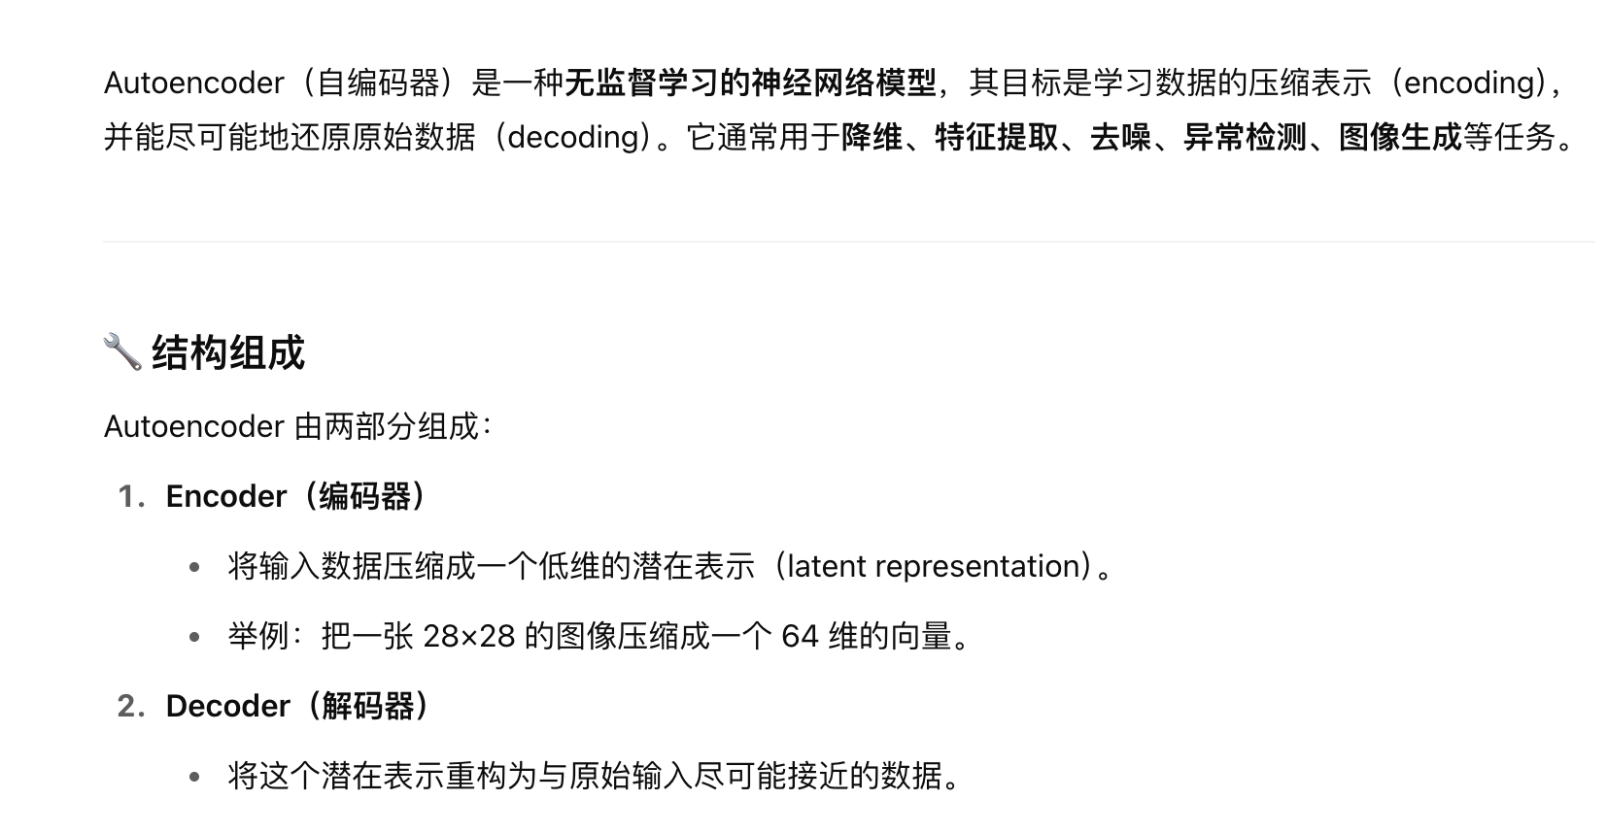
A Simple Autoencoder
We are going to build a simple autoencoder that will take in images of handwritten digits from the MNIST dataset, and learn to reproduce these digits.
Simple example of how to build an autoencoder.
The images will be scaled from 28x28 to 16x16 to reduce training time.
Also a good idea to always scale data to powers of 2 so that we can safely reduce their dimensions using convolutions.
This means that the output image will be of poor quality:
We are condensing a 16x16 image to a 2 element vector.
But this lets us plot the latent vectors to understand what is going on.

Slide 7
Autoencoder Hands On
Load up mnist-ae.ipynb in Jupyter

Slide 8
Autoencoders
We will now build an autoencoder to learn to generate handwritten digits from the MNIST dataset.
We want to visualize the latent space, so we restrict it to a vector of length 3.
This will create very poor quality reproductions but this is ok for what we need.
We will also scale the MNIST images from 28x28 to 16x16 to speed up training time.
It is always good practice to scale the images to powers of 2 as each layer of the encoder divides the image size by 2.
The following slides explain each part of our autoencoder.

Slide 9
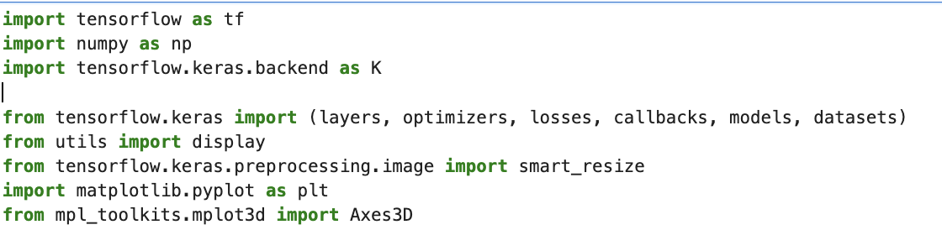
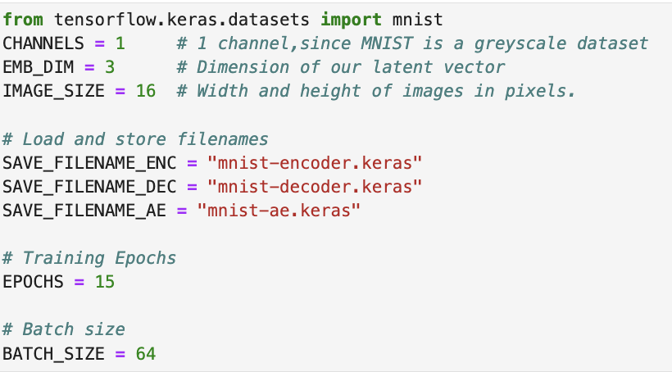
Autoencoders – Imports and Training Parameters
We perform our usual imports. Axes3D lets us do a 3D plot on Matplotlib instead of the usual 2D plots.
We also set some training parameters.

Slide 10
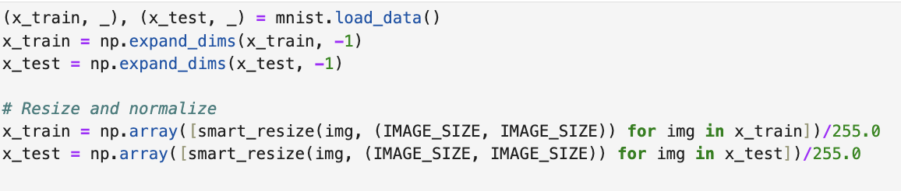
Autoencoders – Loading the Dataset
We load the dataset and use smart_resize to scale to 16x16, and divide by 255 so that we scale the image values from 0 to 1.

Slide 11
Autoencoders – Building the Encoder
We will now build the encoder.
The encoder uses convolutions to learn features of the MNIST images.
It encodes what it learns into a latent vector.
Our encoder will shrink the image by 2x on each axes, but double the number of channels each time.
From 16x16x1 to 8x8x32 to 4x4x64 to 2x2x128
This gives us a good balance of capturing the image details and computational speed.
We flatten the final convolution and use a Dense layer to create the 3-element (i.e. 3 dimension) latent vector.

Slide 12
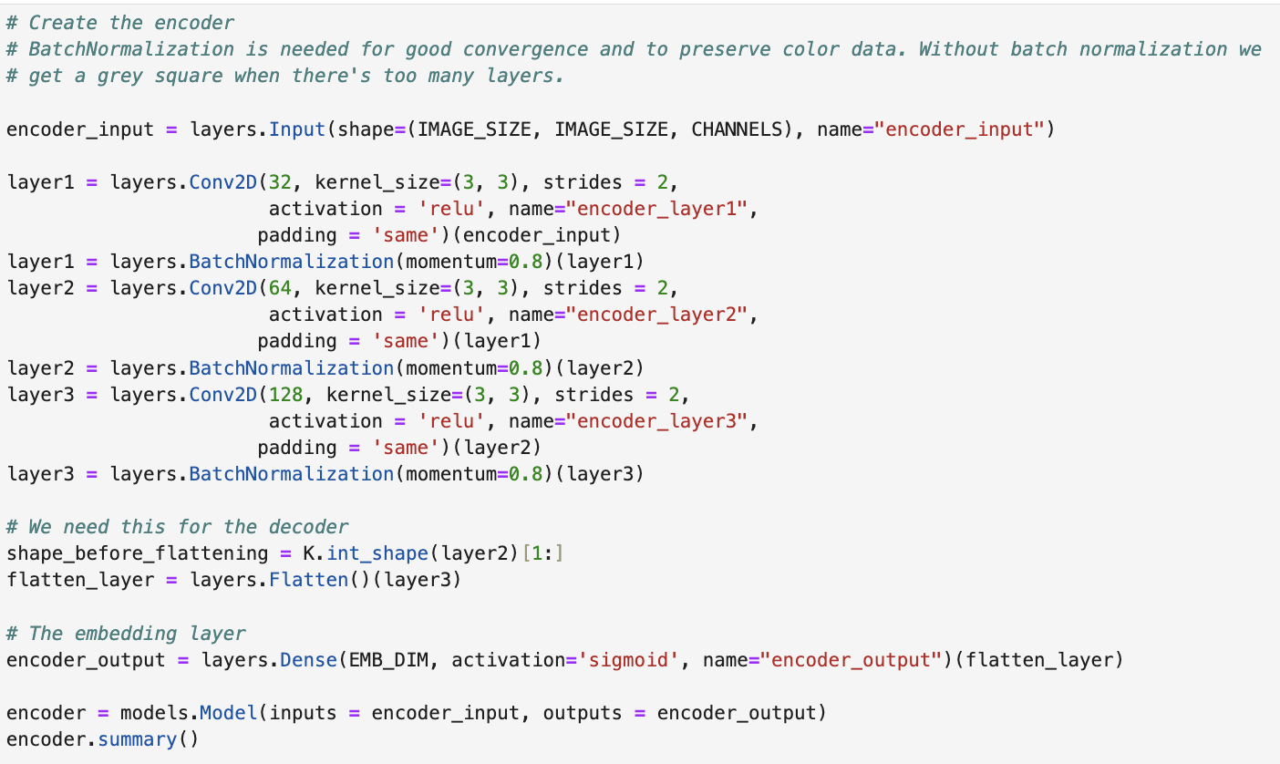
Autoencoders – Building the Encoder

Slide 13
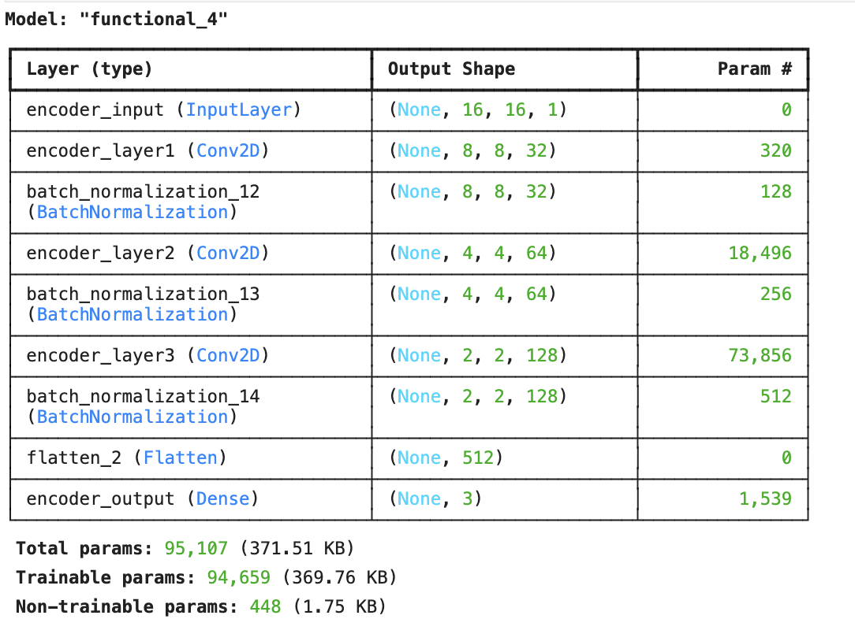
Autoencoders – Building the Encoder

Slide 14
Autoencoders – Building the Decoder
The Decoder takes a latent vector and produces an image out of it.
The latent vector is resized and reshaped to its original 4x4 size.
It is then upscaled back to the original 16x16 image
From 2x2x128 to 4x4x64 to 8z8z32 to 16z16x1
We use Conv2DTranspose to do this.
A 16x16x1 Conv2DTranspose then outputs the final image.

Slide 15
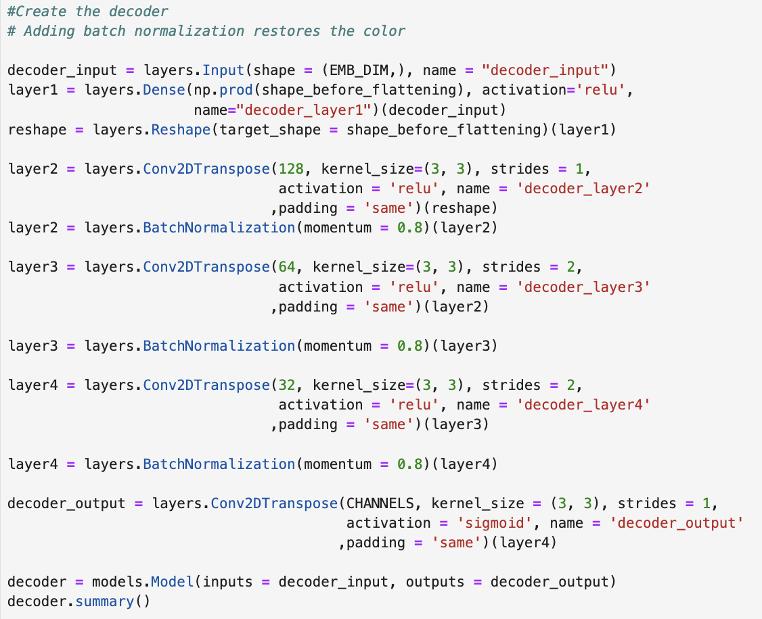
Autoencoders – Building the Decoder

Slide 16
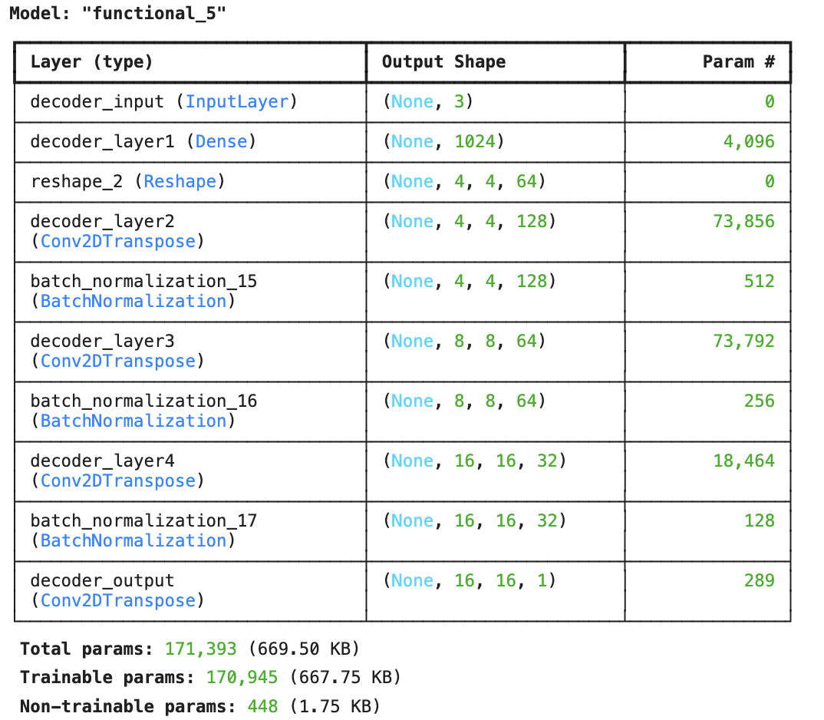
Autoencoders – Building the Decoder

Slide 17
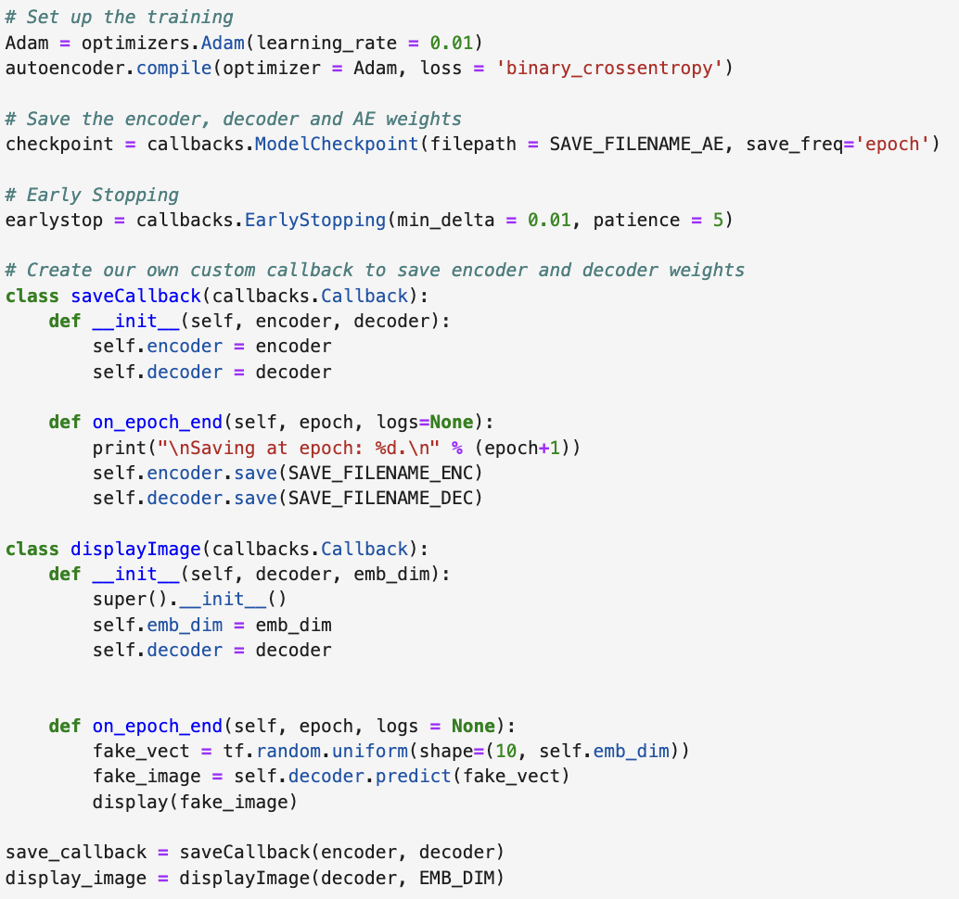
Autoencoders – Compiling the Model, Callbacks
We will now create an Adam Optimizer and compile the model. We will also create some callbacks to save the model after every epoch and to create sample images.

Slide 18
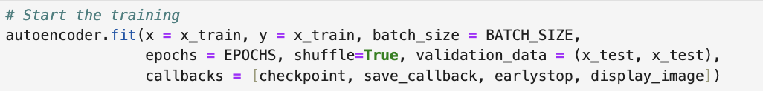
Autoencoders – Training the Model
We use fit as usual to train the model.
Finally, we reconstruct images from the training and testing sets, and generate novel images from a 3D uniform random vector.
See next slide.
Note: For Training and Testing Data, top row is the original data, bottom row is the reconstructed image.

Slide 19
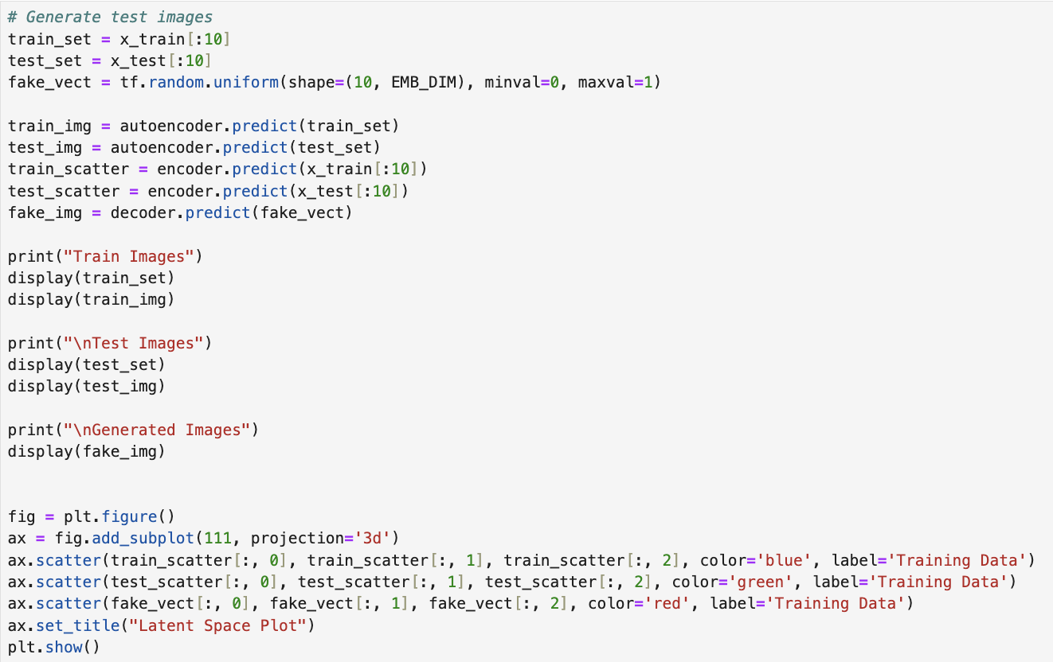
Autoencoders – Testing the Model

Slide 20
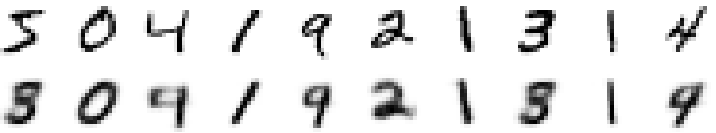
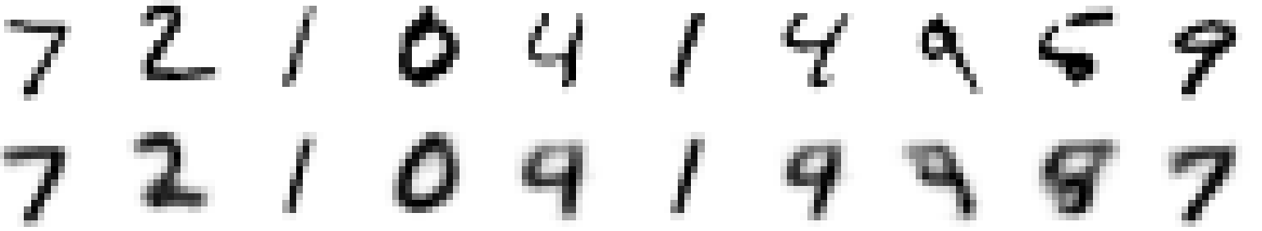
Autoencoders – Results (10 epochs)
Training Data
Testing Data
Novel Data

Slide 21
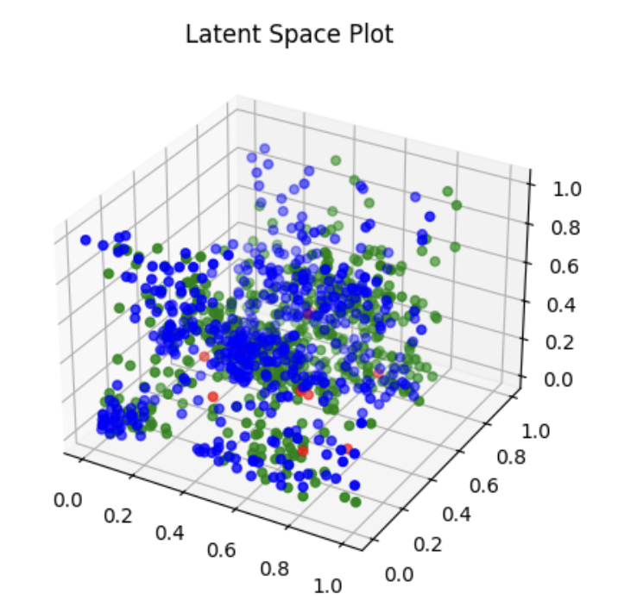
Autoencoders – Results (10 epochs)
We plot the latent vectors for the first 500 images:

Slide 22
variational autoencoders
SWS3009 Embedded Systems and Deep Learning.

Slide 23
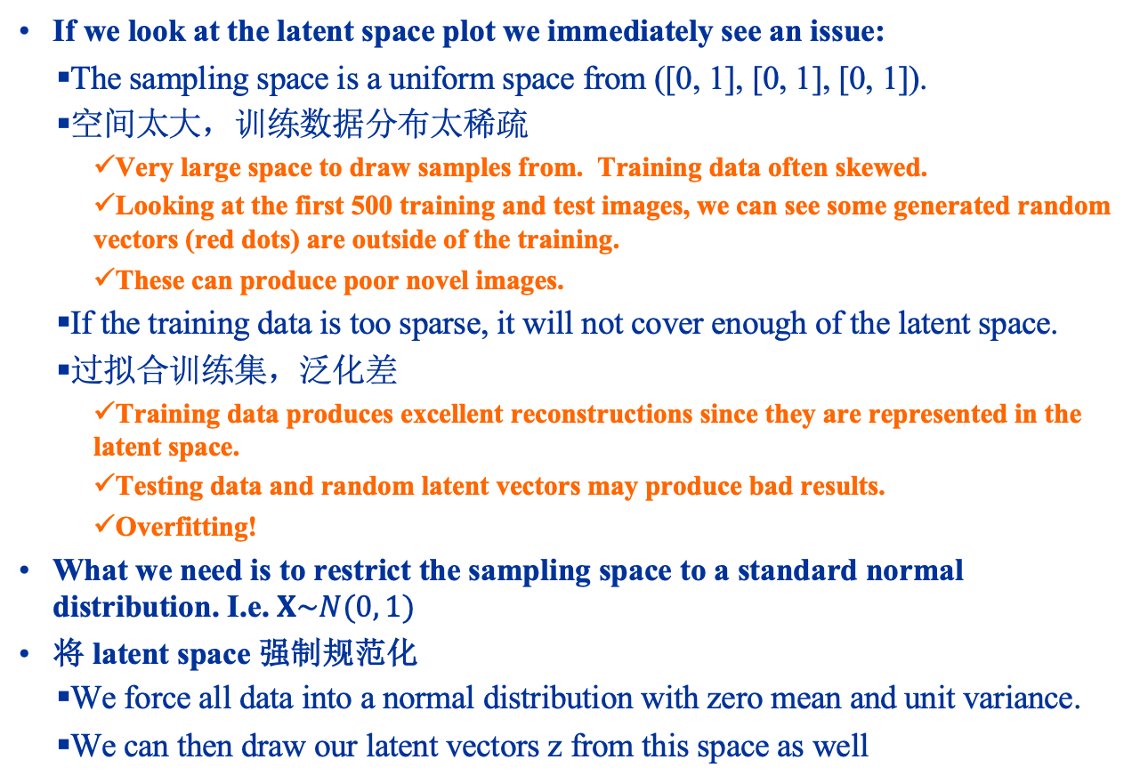
Variational Autoencoders
If we look at the latent space plot we immediately see an issue:
The sampling space is a uniform space from ([0, 1], [0, 1], [0, 1]).
空间太大，训练数据分布太稀疏
Very large space to draw samples from. Training data often skewed.
Looking at the first 500 training and test images, we can see some generated random vectors (red dots) are outside of the training.
These can produce poor novel images.
If the training data is too sparse, it will not cover enough of the latent space.
过拟合训练集，泛化差
Training data produces excellent reconstructions since they are represented in the latent space.
Testing data and random latent vectors may produce bad results.
Overfitting!
What we need is to restrict the sampling space to a standard normal distribution. I.e. $X\sim N(0, 1)$
将 latent space 强制规范化
We force all data into a normal distribution with zero mean and unit variance.
We can then draw our latent vectors z from this space as well

Slide 24
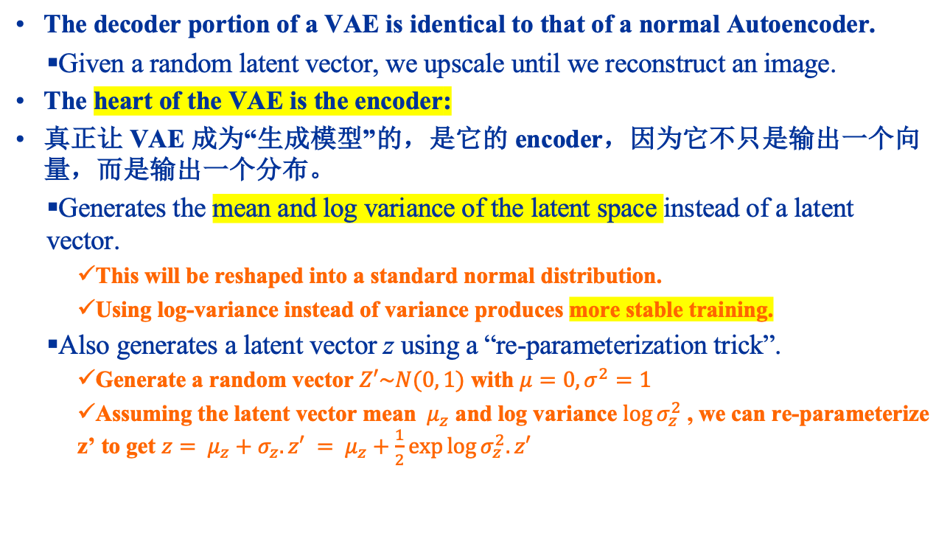
Variational Autoencoders
The decoder portion of a VAE is identical to that of a normal Autoencoder.
Given a random latent vector, we upscale until we reconstruct an image.
The heart of the VAE is the encoder:
真正让 VAE 成为“生成模型”的，是它的 encoder，因为它不只是输出一个向量，而是输出一个分布。
Generates the mean and log variance of the latent space instead of a latent vector.
This will be reshaped into a standard normal distribution.
Using log-variance instead of variance produces more stable training.
Also generates a latent vector z using a “re-parameterization trick”.
Generate a random vector $Z′\sim N(0, 1)$ with $μ=0, σ^{2}=1$
Assuming the latent vector mean ${ μ}_{z}$ and log variance $\log{σ_{z}^{2}}$ , we can re-parameterize z’ to get $z= μ_{z}+σ_{z}.z′$ $= μ_{z}+\frac{1}{2}\exp{\log{σ_{z}^{2}.z′}}$

Slide 25
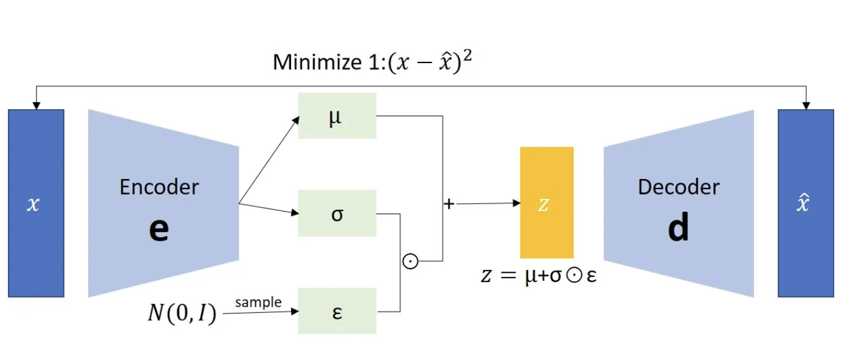
Variational Autoencoders

Slide 26
Autoencoder Hands On
Load up MNIST-VAE.ipynb in Jupyter

Slide 27
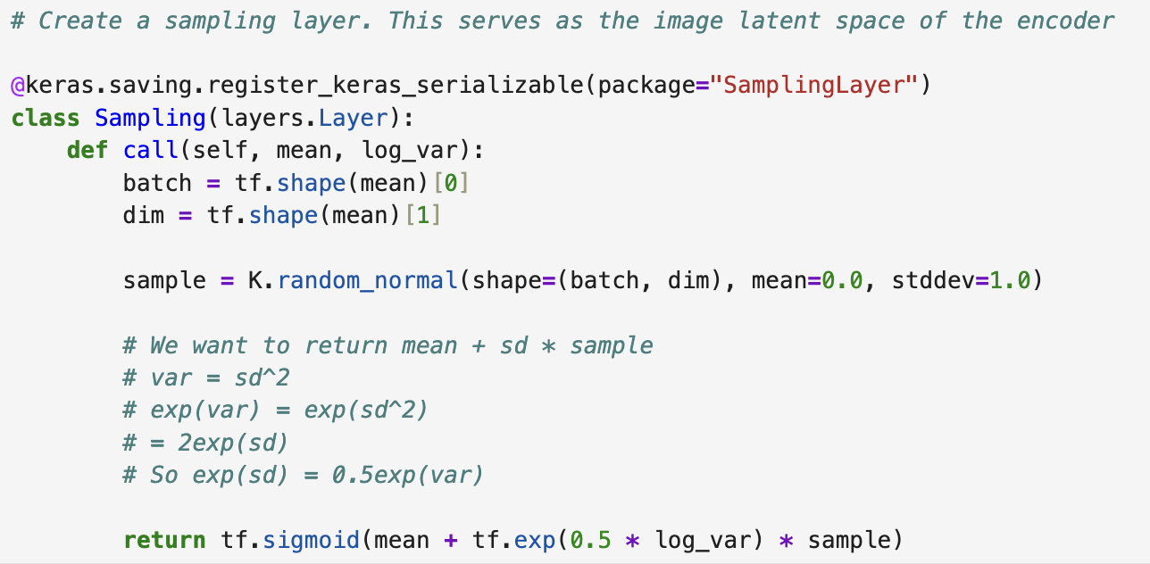
Variational Autoencoders The Encoder
The Sampling Layer
This generates the latent vector from a random sample drawn from a standard normal, and re-parameterized to the generated mean and log variance.

Slide 28
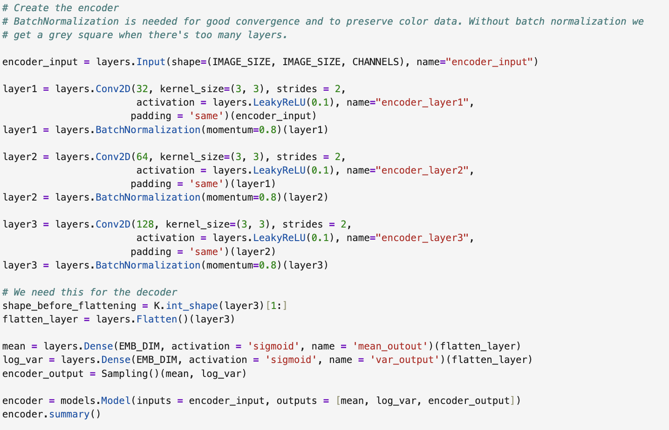
Variational Autoencoders The Encoder
We now create an encoder like the one in our autoencoder, except that it now generates a latent vector mean and log-variance, as well as the latent vector using the sampling later.

Slide 29
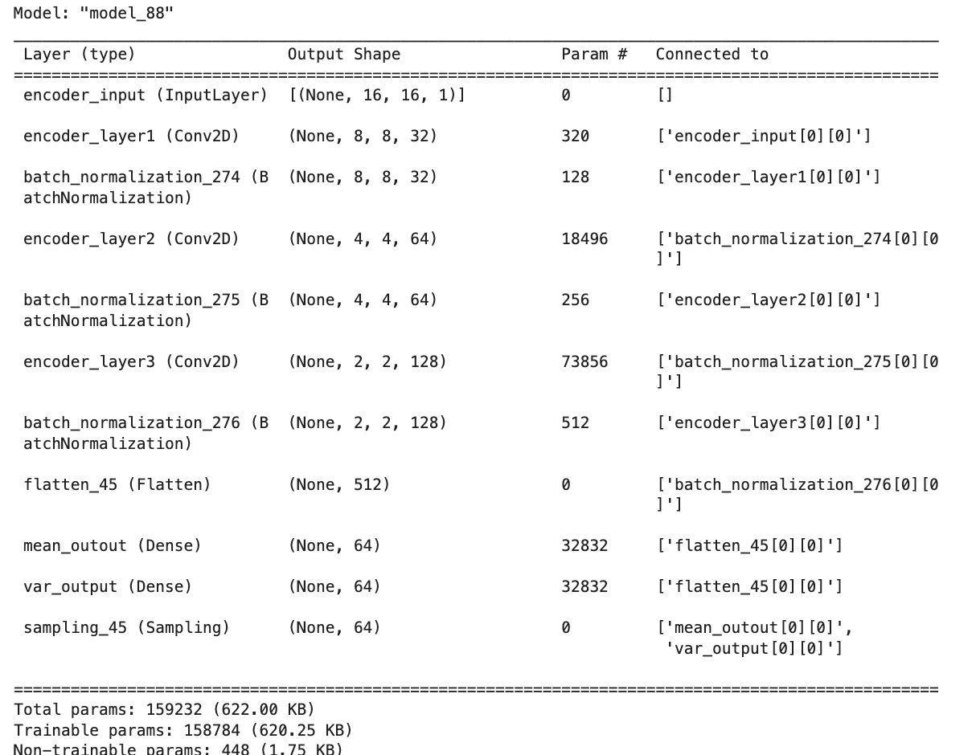
Variational Autoencoders The Encoder

Slide 30
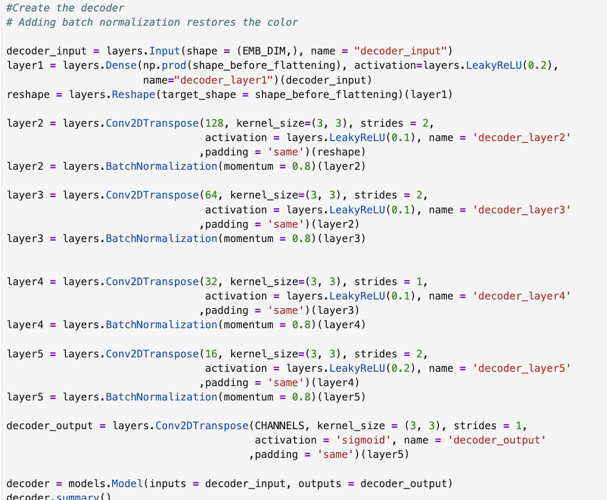
Variational Autoencoders The Decoder
The Decoder is identical to our original AE.
Takes the latent vector generated by the sampling later, and reconstructs and image.

Slide 31
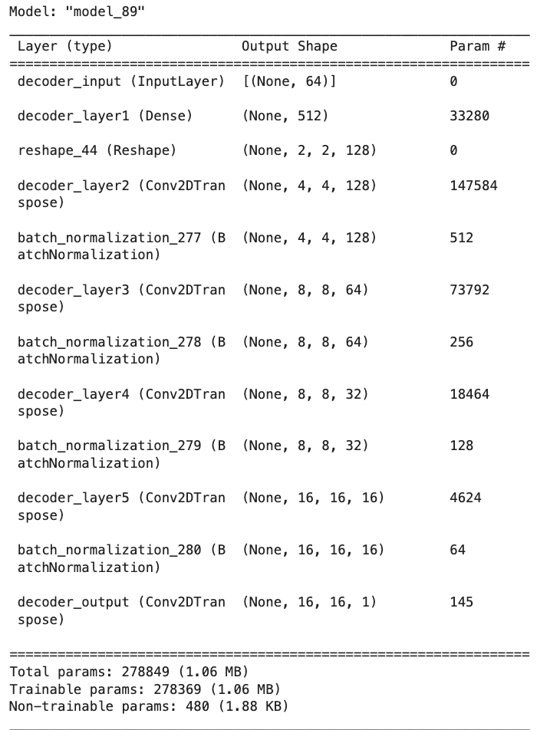
Variational Autoencoders The Decoder

Slide 32
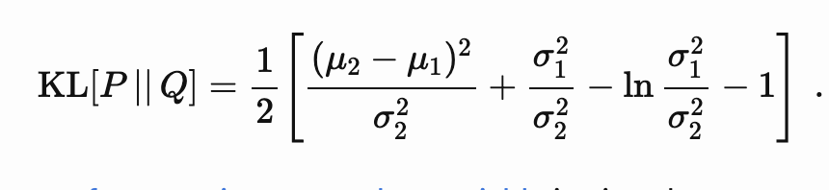
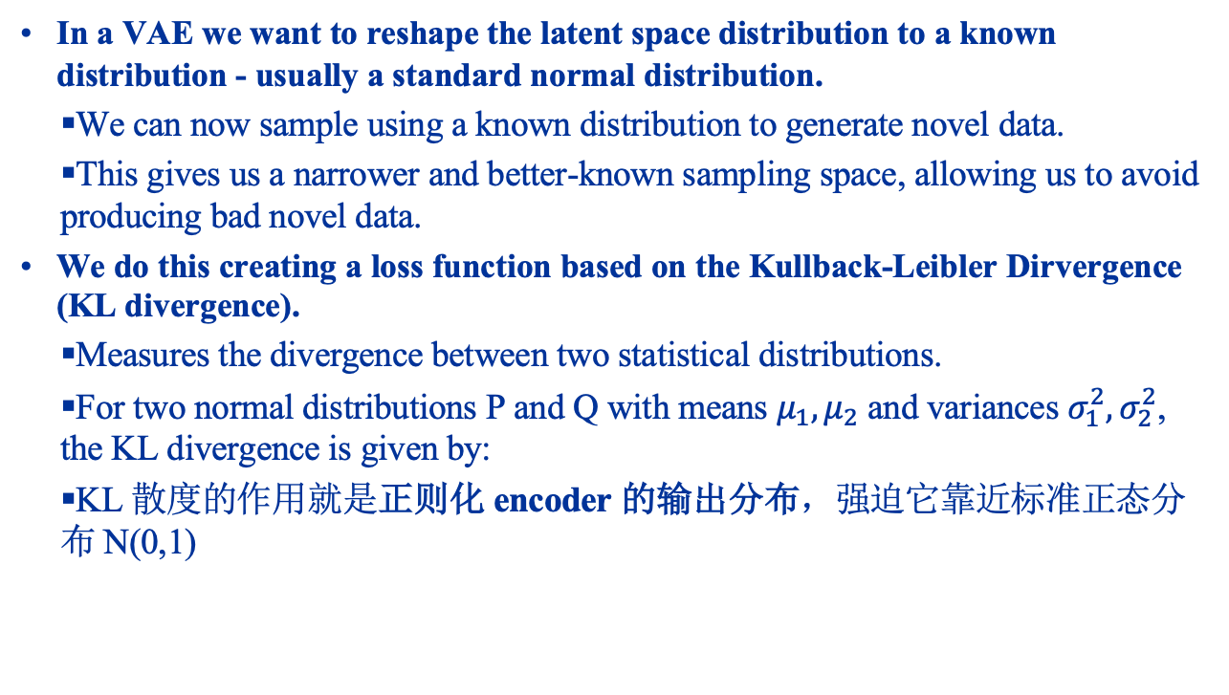
Variational Autoencoders Training
In a VAE we want to reshape the latent space distribution to a known distribution - usually a standard normal distribution.
We can now sample using a known distribution to generate novel data.
This gives us a narrower and better-known sampling space, allowing us to avoid producing bad novel data.
We do this creating a loss function based on the Kullback-Leibler Dirvergence (KL divergence).
Measures the divergence between two statistical distributions.
For two normal distributions P and Q with means $μ_{1}, μ_{2}$ and variances $σ_{1}^{2}, σ_{2}^{2}$, the KL divergence is given by:
KL 散度的作用就是正则化 encoder 的输出分布，强迫它靠近标准正态分布 N(0,1)

Slide 33
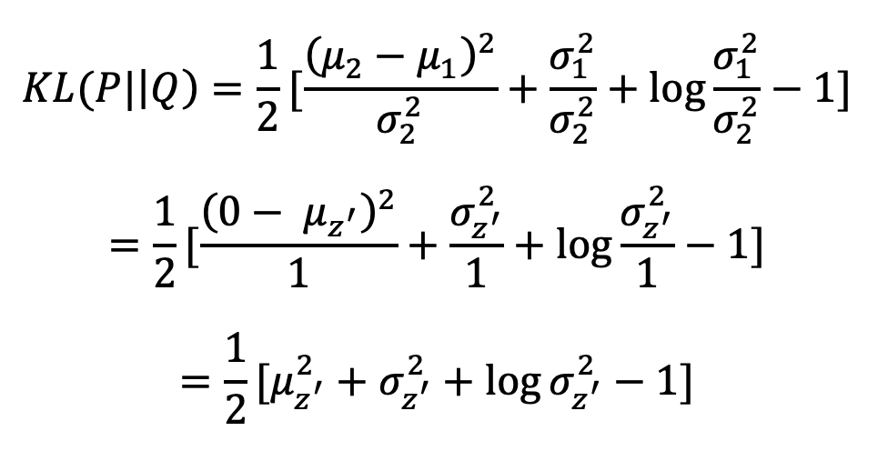
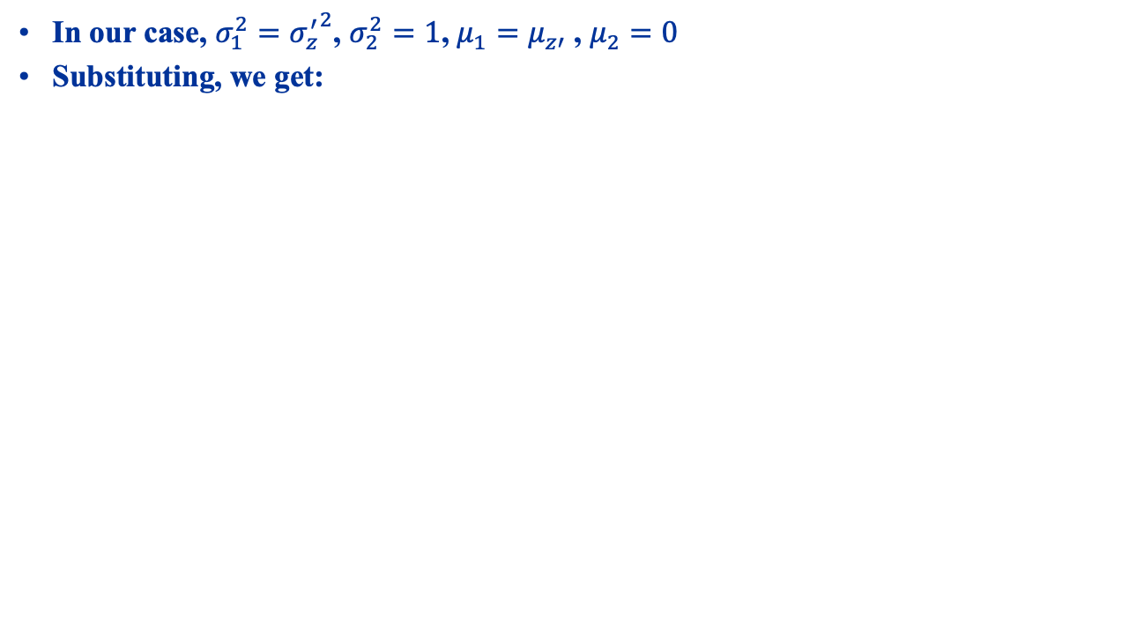
Variational Autoencoders Training
In our case, $σ_{1}^{2}={σ_{z}^{′}}^{2}$, $σ_{2}^{2}=1$, $μ_{1}=μ_{z′}$ , $μ_{2}=0$
Substituting, we get:

Slide 34
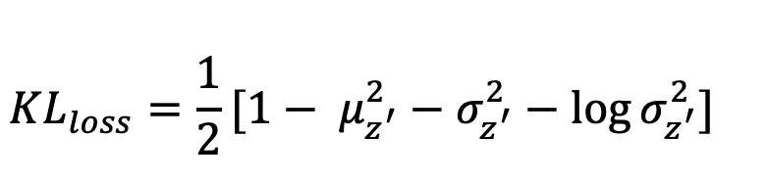
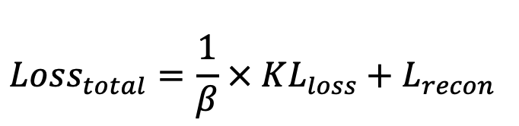
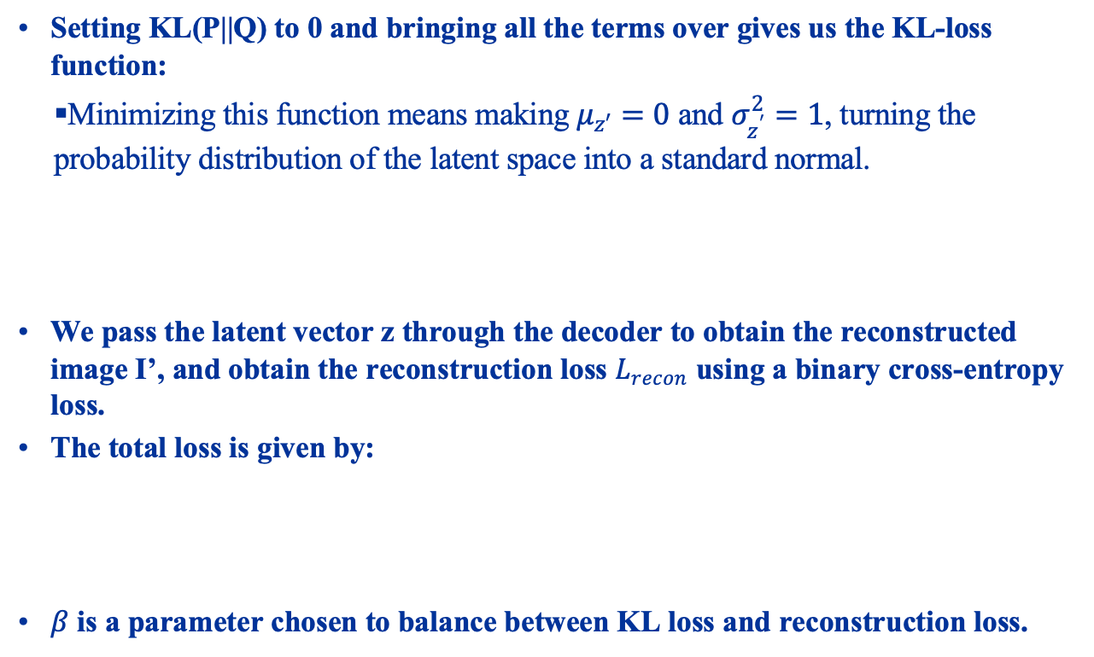
Variational Autoencoders Training
Setting KL(P||Q) to 0 and bringing all the terms over gives us the KL-loss function:
Minimizing this function means making $μ_{z′}=0$ and $σ_{z^{′}}^{2}=1$, turning the probability distribution of the latent space into a standard normal.
We pass the latent vector z through the decoder to obtain the reconstructed image I’, and obtain the reconstruction loss $L_{recon}$ using a binary cross-entropy loss.
The total loss is given by:
$β$ is a parameter chosen to balance between KL loss and reconstruction loss.

Slide 35
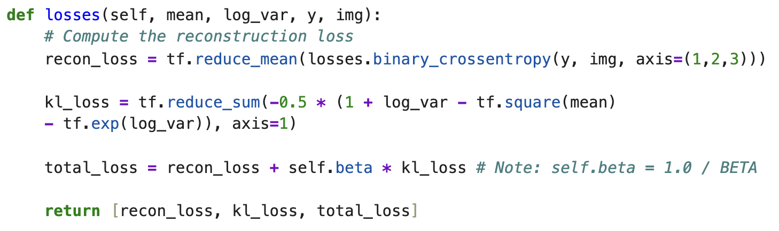
Variational Autoencoders Training - Loss Function

Slide 36
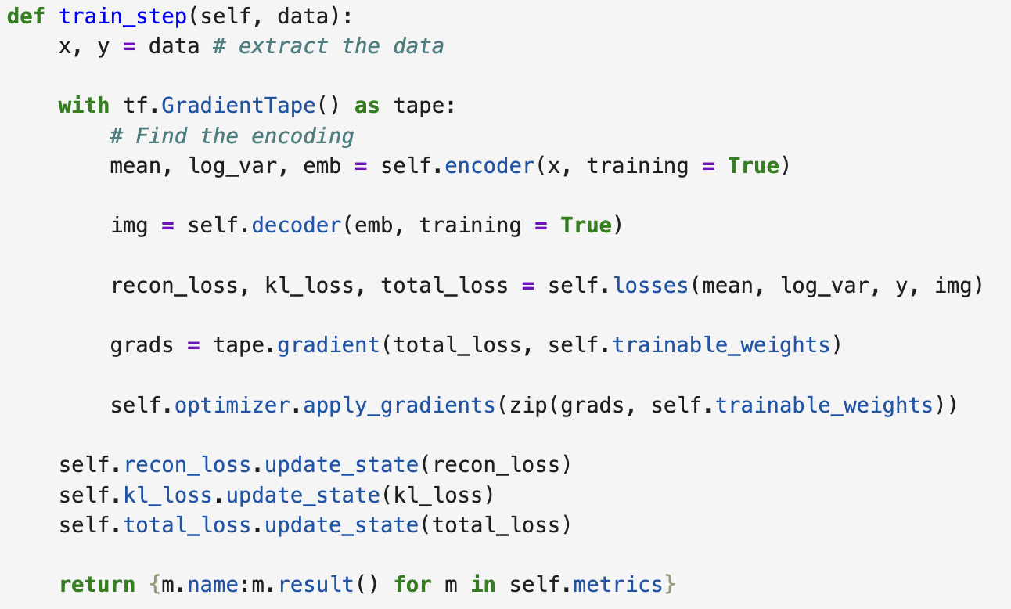
Variational Autoencoders Training – Custom Training Step

Slide 37
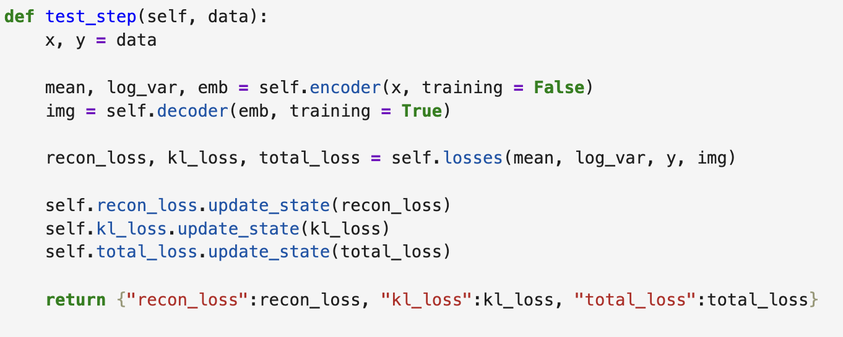
Variational Autoencoders Training – Custom Testing Step

Slide 38
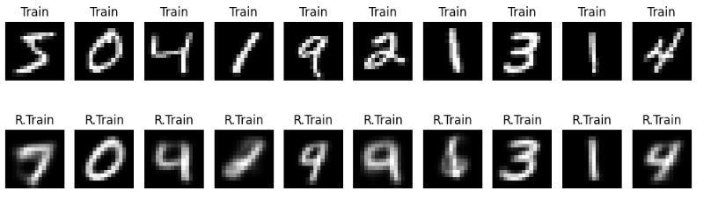
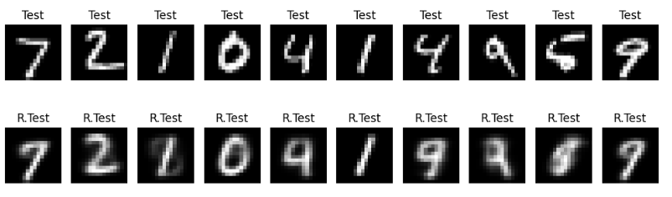
Variational Autoencoders Results
Training Images and Reconstruction
Test images and reconstruction:

Slide 39
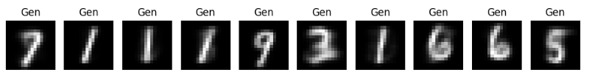
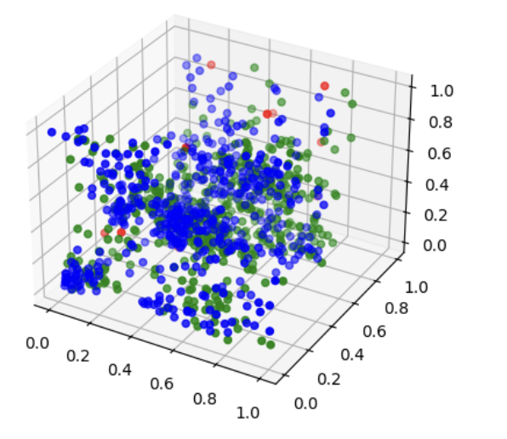
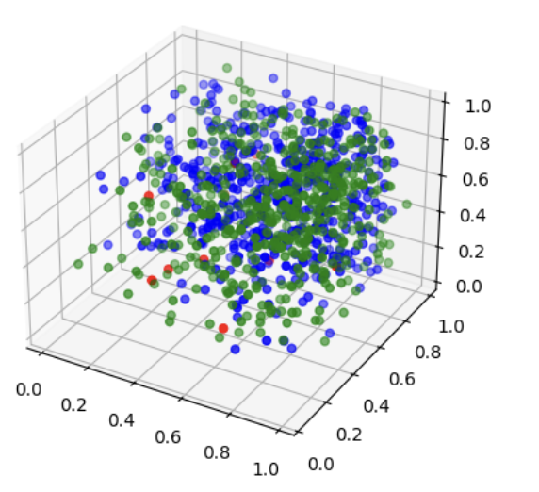
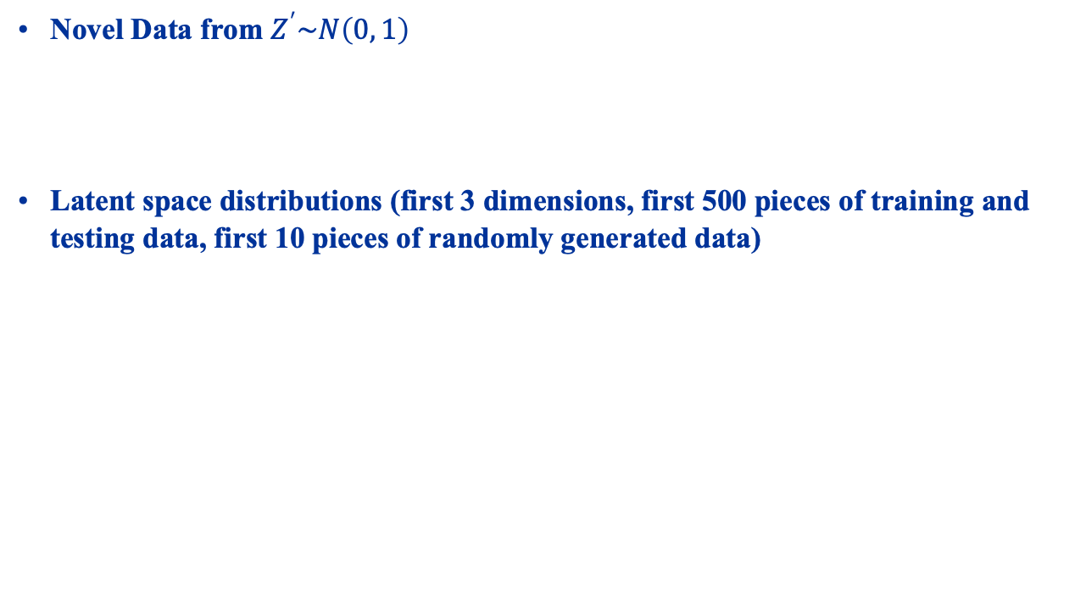
Variational Autoencoders Results
Novel Data from $Z^{′}\sim N\left(0, 1\right)$
Latent space distributions (first 3 dimensions, first 500 pieces of training and testing data, first 10 pieces of randomly generated data)
Autoencoder
VAE

Slide 40
generator adversarial networks
SWS3009 Embedded Systems and Deep Learning.

Slide 41
Generative Adversarial Networks What Are They?
We now look at Generative Adversarial Networks, or GANs.
Motivation:
We often don’t have enough training data.
We want to build a neural network that will produce “fake” data from the real data.
Consists of two networks:
A “Generator” network that learns how to “counterfeit” the data.
Like a forger learning how to make better and better counterfeit money.
A “Discriminator” network that learns how to differentiate between the real and the fake data.
Like a cop learning to differentiate between the increasingly good counterfeit money from the real money.
We can use GANs to do very cool things like:
Producing images of people who don’t exist (!!).

Slide 42

Generative Adversarial Networks What Are They?
The diagram below shows this idea:
Generator:
Random noise is presented to the generator.
The generator uses this to create its fake data.
Discriminator:
Both fake and real data are presented to the discriminator.
Discriminator is trained how to differentiate them.

Slide 43
Generative Adversarial Networks How Do They Work?
Training the Generator:
Weights for the Discriminator are frozen.
The GAN is now trained on the assumption that the fake data is real.
End result: The Generator adjusts its weights to try to maximize the “realness” of the fake data.
The process repeats.
So training alternates between:
Maximizing the Discriminator’s ability to tell fake data from real.
Maximizing the quality of the fake data to minimize the Discriminator’s ability to differentiate.
This is why it is called an “adversarial network”:
The two networks try to fight each other.

Slide 44
Autoencoder Hands On
Load up gan.py

Slide 45
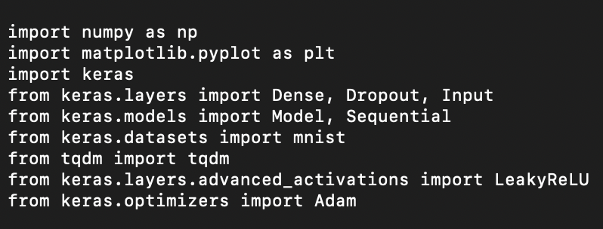
Generative Adversarial Networks Imports
We will now build a GAN to generate fake MNIST data. Create a new file called “gan.py” and key in the following.
As always we begin with the imports:

Slide 46
Generative Adversarial Networks LeakyReLU
Most of this is pretty standard, except for:
Matplotlib: This is a plotting library. Does not work properly on MacOS but we can still use it to generate PNG files.
Tqdm: This is a very cool progress bar library.
We are also importing a new activation function called LeakyReLU

Slide 47
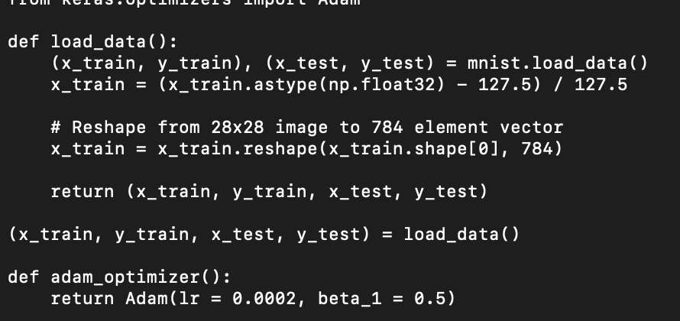
Generative Adversarial Networks Preparing the Data
We load the MNIST data, pretty much the same as before.
Also since we are using the Adam optimizer twice (once each for the Generator and Discriminator), we create a function to create the optimizer.

Slide 48
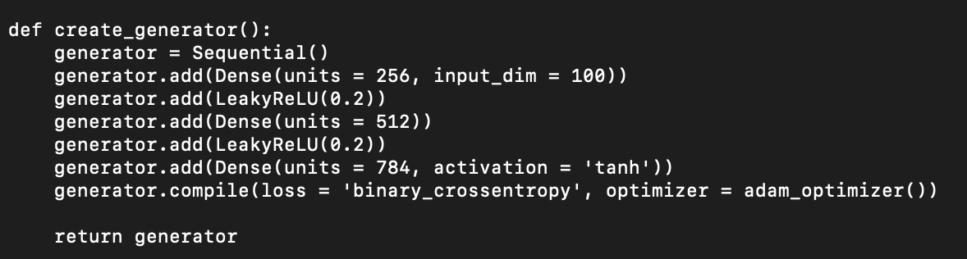
Generative Adversarial Networks Building the Generator
Now we create the Generator network. This is a simple MLP with:
A 100 element input, which will be filled with 100 random numbers.
Two hidden layers.
A 784 element output since our image is 28x28.
Here we use LeakyReLU with a = 0.2, so we have f(x) = 0.2x when x < 0 and f(x) = x when x > 0. f(0) is defined to be 0.

Slide 49
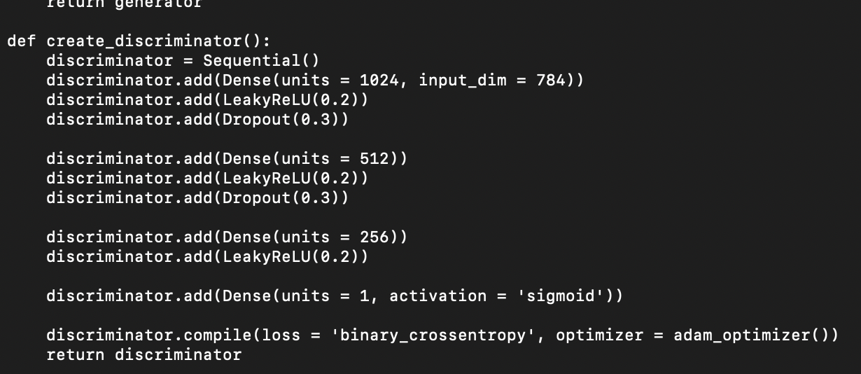
Generative Adversarial Networks Building the Discriminator
We similarly create the Discriminator. It has:
784 inputs, which is our 28x28 real or fake image.
Three hidden layers.
A single output which will be set to either 0 (fake) or 1 (true).

Slide 50
Generative Adversarial Networks Building the GAN
Now we create the GAN. This is relatively simple:
Take as inputs the Generator and Discriminator.
Create an input layer.
Pass the input to the Generator to create the fake image.
Pass this image to the Discriminator.
Set the GAN’s input to the new input layer, and the GAN’s output to the output of the Discriminator.
We use a binary cross-entropy loss since we are doing a binary 0/1 classification.

Slide 51
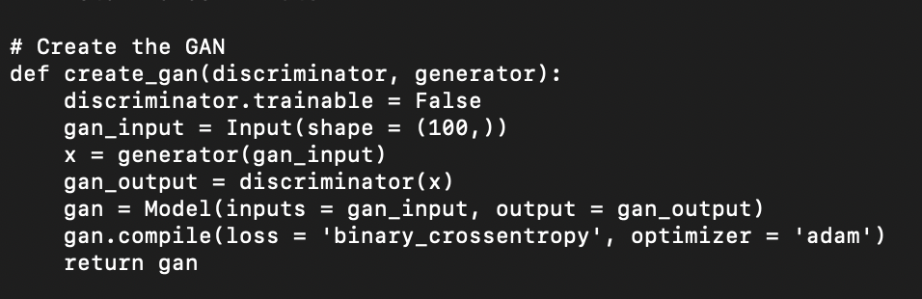
Generative Adversarial Networks Building the GAN

Slide 52
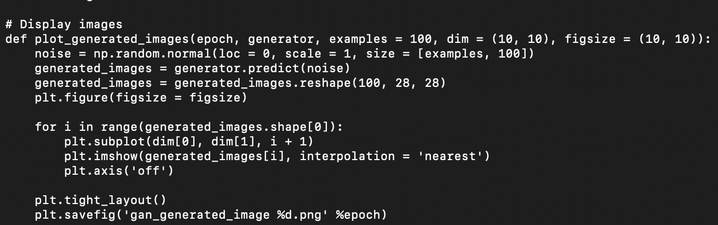
Generative Adversarial Networks Helper Function
Now we create a little helper function just to plot the generated images.

Slide 53
Generative Adversarial Networks Training
Finally we come to the fun part: Training!
Create the Generator, Discriminator and GAN networks, and load the data.
In each epoch, for the Discriminator:
Generate fake data using random numbers.
Randomly choose real data, and combine with fake data,
Tag the real data with “1” and the fake data with ”0”.
Train the Discriminator.
In each epoch, for the Generator:
Freeze the Discriminator’s weights.
Generate the fake data using random numbers.
Train the GAN with the assumption that the fake data is real.
This forces the Generator to optimize its weights to maximize its score from the Discriminator (i.e. “convincing” the Discriminator to output a 1 instead of 0)
The Discriminator itself is not affected since its weights are frozen.

Slide 54
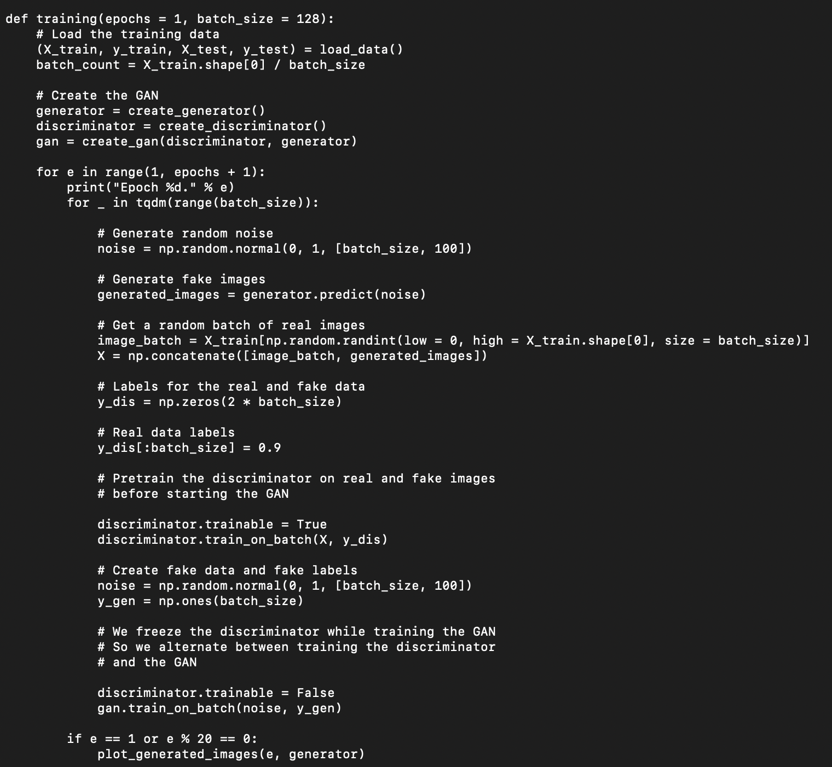

Slide 55
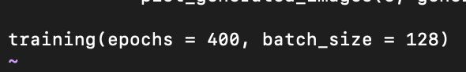
Generative Adversarial Networks
We end with just a single call to train for 400 epochs, with batch size of 128:
When run, the program will display the generated images on the screen (does not work with MacOS) and output to the PNG file with the filename “gan_generated_image xxx.jpg” where xxx is the epoch number.
Next slide shows the results at various epochs.

Slide 56
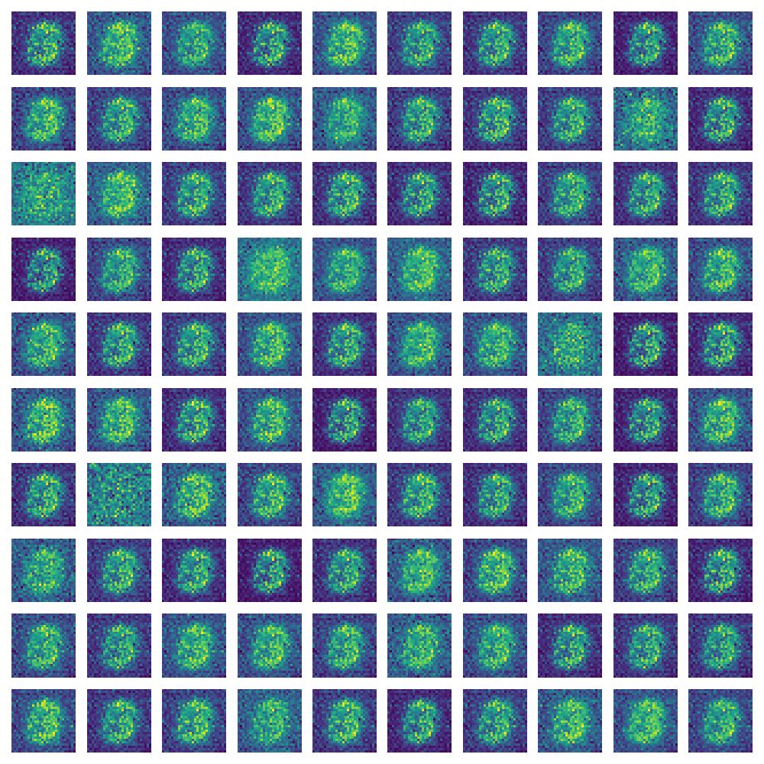
Generative Adversarial Networks Epoch 1

Slide 57
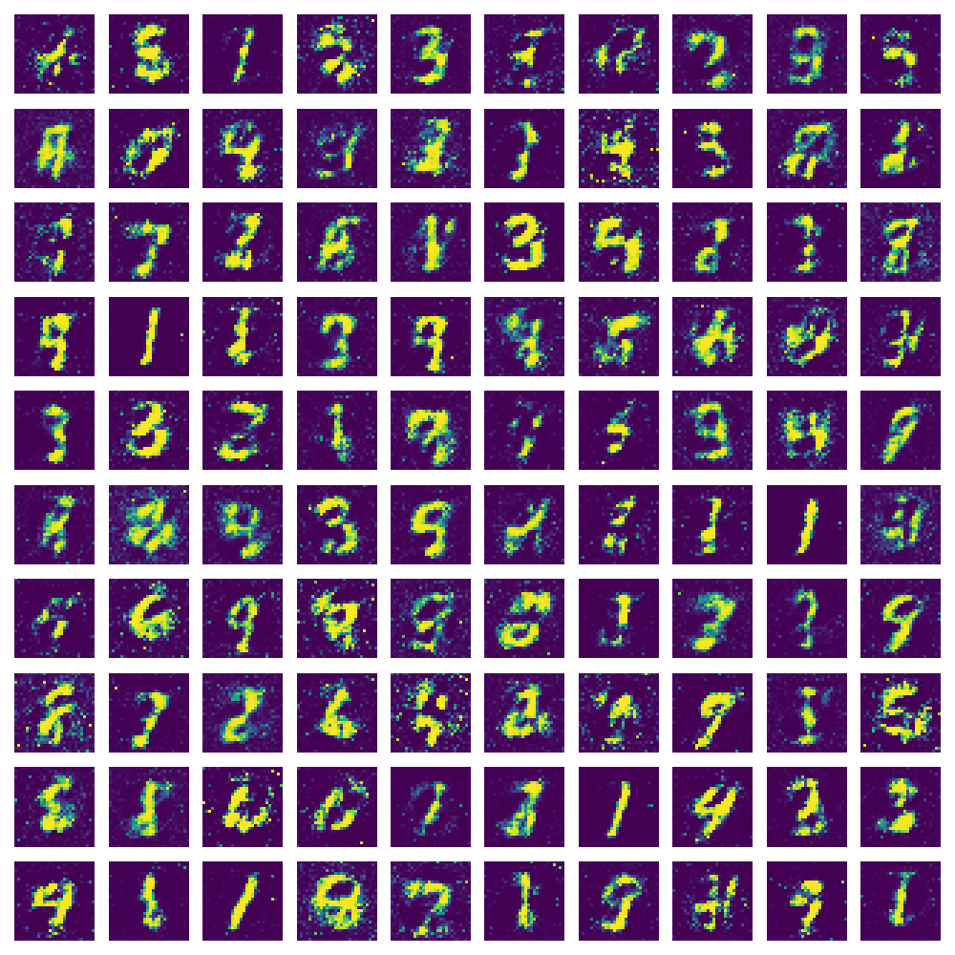
Generative Adversarial Networks Epoch 20

Slide 58
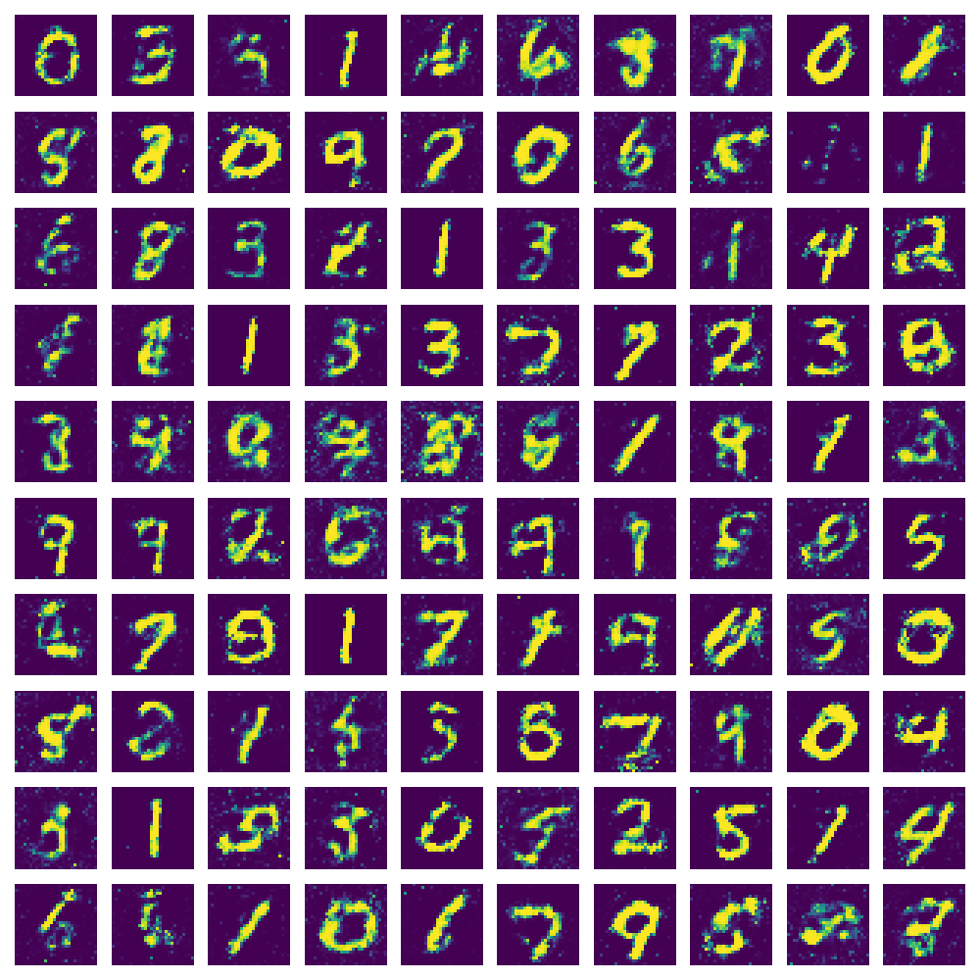
Generative Adversarial Networks Epoch 60

Slide 59

Generative Adversarial Networks Epoch 100

Slide 60

Generative Adversarial Networks Epoch 200

Slide 61

Generative Adversarial Networks Epoch 400

Slide 62
diffusion models
SWS3009 Embedded Systems and Deep Learning.

Slide 63

Diffusion Models
Diffusion models are amongst the most popular generative models today – particularly Stable Diffusion.
Basic operating principle:
Goal: To be able to generate novel images similar to the training data using random noise.
Forward Step: Take an image, and progressively corrupt it with noise over many steps, until it becomes indistinguishable from random gaussian noise.
Backward Step: Using the progressively corrupted images we train a denoiser to predict the noise in an image and remove it.

Slide 64
Autoencoder Hands On
Load up diffusion.ipynb in Jupyter

Slide 65



Diffusion Models Noising Step
We will now examine each part of a diffusion model.
Forward noise step:
We gradually introduce Gaussian noise to an image over T steps using a linear schedule.
This causes rapid noising of the image, which is not desirable for training.
We instead use a cosine beta noise schedule:

Slide 66

Diffusion Models Noising Step

Slide 67



Diffusion Models Noising Step
Adding the Noise

Slide 68


Diffusion Models Noising Step
Noise introduced using a linear schedule:
Noise introduced using a cosine schedule:

Slide 69

Diffusion Models Noise Prediction
Using the gradually corrupted images and the (known) noise used to corrupt the image, we now train a deep learning network to predict noise based on the input image.
Any CNN-based deep-learning network can be used to predict the noise, but we often use a powerful architecture called a Unet:

Slide 70


Diffusion Models Noise Prediction
Skip Connections
A Unet consists of:
A series of “down-sampling” encoder blocks.
Extracts high-level features
Reduces image size but across more channels
A “choke” block that holds the encoded image in the lowest resolution but across the most number of channels.
A series of ”up-sampling” decoder blocks that reconstruct the noise at the original image resolution.
Skip connections between downsampling and upsampling blocks to share information, and to promote gradient flows.
Essential for very deep networks, where gradients can decompose to 0.
Downsampling
Upsampling

Slide 71

Diffusion Models Noise Prediction

Slide 72

Diffusion Models Timestep Embedding
In our noising algorithm, we added very little noise at the beginning, and much more at the end.
So not only is the noise pattern important, but so is its intensity.
The Unet must therefore know what time step we are in, to produce the correct intensity.
Problem: Time-steps are not smooth - there are discontinuities at the boundary of each value:

Slide 73

Diffusion Models Timestep Embedding
We instead embed each time step as an alternating series of sines and cosines.
Here d is the embedding dimension.
Provides a richer, smoother representation of each time step as a series of numbers generated by smooth functions, rather than discrete steps.

Slide 74


Diffusion Models Timestep Embedding
模型在预测时，需要“知道”当前处于哪个时间步，因为不同时间步噪声特征不同。 为此，我们把时间步 t 映射成一个向量（embedding），提供给模型使用。

Slide 75

Diffusion Models Training
Diffusion Network Training
Take an image.
Create T versions of the image with progressively more noise. The final image should be indistinguishable from pure Gaussian noise.
Use the progressively noisy image and the noise used to create the image to trin the Unet.
Goal: Given a noisy image, predict the noise that’s in the image.
This prediction can then be used to clean the image.

Slide 76

Diffusion Models Training

Slide 77


Diffusion Models Denoising
To generate an image from random Guassian noise:
We begin with our fully random image $x_{t}$ at time t.
We predict the noise $ε_{θ}(x_{t}, t)$ in the image $x_{t}$
We apply the “reverse sampling” formula to remove the predicted noise, to derive a “less noisy” image $x_{t−1}$
Repeat until we get the final “noiseless” image $x_{0}$, which is just $μ_{0}$

Slide 78


Diffusion Models Denoising

Slide 79
Diffusion Models Stable Diffusion
Stable Diffusion is a very popular image generation algorithm.
It is identical to the Diffusion Model we have just discussed, except:
A VAE is used to generate a latent vector representing each image.
We add noise to the latent vector instead of the entire image – this is much more efficient since the latent vectors are smaller than the image (e.g. 256 bytes vs 3136 bytes for MNIST images).
We add in text embeddings into the Unet training so that it can generate images based on text prompts.

Slide 80
conditional generation
SWS3009 Embedded Systems and Deep Learning.

Slide 81
Conditional Generation
Our generative models produce novel images using random noise.
This means we don’t have any control over what is generated.
It would be much more useful if we could control exactly what was being generated.
E.g. in the MNIST dataset, specify whether to generate ‘0’, ‘2’, etc.
This is known as conditional generation.
Used in:
ChatGPT, Deepseek to answer questions.
Stable Diffusion to generate images.
etc.

Slide 82
Conditional Generation Principle
This is actually quite easy to do:
Currently we only use the example images to train the generative networks.
To do conditional generation, we train the networks with the image AND their labels.
We look at an example VAE trained on one-hot labels.
If we are using sentences, we can use word embeddings instead.

Slide 83

Conditional Generation VAE Encoder

Slide 84

Conditional Generation VAE Decoder

Slide 85

Conditional Generation VAE Training

Slide 86
Summary
Over the past few lectures we have looked at various methods of machine learning:
Neural Networks: Slow learning, potentially very powerful, can learn very complex patterns. Can be prone to overfitting due to high density of the parameters.
Deep Networks: Very large complex networks, but made up of many often heterogeneous types of networks that try to simplify the inputs, so that we can use a relatively small dense network to perform final decisions.
We also looked at generative networks that can produce novel data.
In the next lecture we will look at statistical methods:
Fast, based on sound statistical and information theory. May not handle scale and complexity well.
We’ve also seen how these have been applied to solve various problems.
Think about what sort of problem you’d like to solve for your project.
Think about the kind of machine learning architectures.
Start collecting potentially relevant data (from places like Kaggle) and experiment.

